Slide 1

More Graph Algorithms
Data Structures and Algorithms

Slide 2
Announcements
Calendar on the webpage has updated office hours for this week.
Last Time:
Dijkstra’s Algorithm to find shortest paths.
Today:
Two more problems on directed graphs

Slide 3
Problem 1: Ordering Dependencies
Today’s (first) problem: Given a bunch of courses with prerequisites, find an order to take the courses in.
Math 126
CSE 374
CSE 143
CSE 142
CSE 373
CSE 417

Slide 4
Problem 1: Ordering Dependencies
Given a directed graph G, where we have an edge from u to v if u must happen before v.
We can only do things one at a time, can we find an order that respects dependencies?
Given: a directed graph G
Find: an ordering of the vertices so all edges go from left to right.
Topological Sort (aka Topological Ordering)
Uses:
Compiling multiple files
Graduating.

Slide 5
Topological Ordering
A course prerequisite chart and a possible topological ordering.
Math 126
CSE 374
CSE 143
CSE 142
CSE 373
CSE 417
Math 126
CSE 142
CSE 143
CSE 373
CSE 374
CSE 417

Slide 6
Can we always order a graph?
Can you topologically order this graph?
A
B
C
A directed graph without any cycles.
Directed Acyclic Graph (DAG)
A graph has a topological ordering if and only if it is a DAG.
Notes:
3:00

Slide 7
Ordering a DAG
Does this graph have a topological ordering? If so find one.
A
C
D
B
E
If a vertex doesn’t have any edges going into it, we can add it to the ordering.
More generally, if the only incoming edges are from vertices already in the ordering, it’s safe to add.

Slide 8
How Do We Find a Topological Ordering?
TopologicalSort(Graph G, Vertex source)
count how many incoming edges each vertex has
Collection toProcess = new Collection()
foreach(Vertex v in G){
if(v.edgesRemaining == 0)
toProcess.insert(v)
}
topOrder = new List()
while(toProcess is not empty){
u = toProcess.remove()
topOrder.insert(u)
foreach(edge (u,v) leaving u){
v.edgesRemaining--
if(v.edgesRemaining == 0)
toProcess.insert(v)
}
}

Slide 9
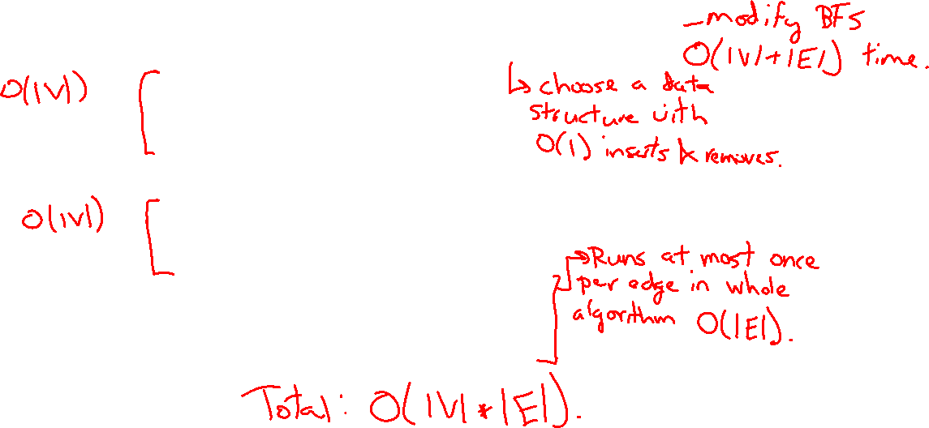
What’s the running time?
TopologicalSort(Graph G, Vertex source)
count how many incoming edges each vertex has
Collection toProcess = new Collection()
foreach(Vertex v in G){
if(v.edgesRemaining == 0)
toProcess.insert(v)
}
topOrder = new List()
while(toProcess is not empty){
u = toProcess.remove()
topOrder.insert(u)
foreach(edge (u,v) leaving u){
v.edgesRemaining--
if(v.edgesRemaining == 0)
toProcess.insert(v)
}
}

Slide 10
Strongly Connected Components
Notes:
12:30

Slide 11
Connected [Undirected] Graphs
Connected graph – a graph where every vertex is connected to every other vertex via some path. It is not required for every vertex to have an edge to every other vertex
There exists some way to get from each vertex to every other vertex
Connected Component – a subgraph in which any two vertices are connected via some path, but is connected to no additional vertices in the supergraph
There exists some way to get from each vertex within the connected component to every other vertex in the connected component
A vertex with no edges is itself a connected component
Robb
Sansa
Rickon
Dany
Viserys
Arya
Jon
Bran

Slide 12
Strongly Connected Components
A subgraph C such that every pair of vertices in C is connected via some path in both directions, and there is no other vertex which is connected to every vertex of C in both directions.
Strongly Connected Component
A
D
E
B
C
Note: the direction of the edges matters!

Slide 13
Strongly Connected Components Problem
A
B
D
E
K
C
F
J
{A}, {B}, {C,D,E,F}, {J,K}
Given: A directed graph G
Find: The strongly connected components of G
Strongly Connected Components Problem

Slide 14
SCC Algorithm
Ok. How do we make a computer do this?
You could:
run a [B/D]FS from every vertex,
For each vertex record what other vertices it can get to
and figure it out from there.
But you can do better. There’s actually an O(|V|+|E|) algorithm!
I only want you to remember two things about the algorithm:
It is an application of depth first search.
It runs in linear time
The problem with running a [B/D]FS from every vertex is you recompute a lot of information.
The time you are popped off the stack in DFS contains a “smart” ordering to do a second DFS where you don’t need to recompute that information.

Slide 15
Why Find SCCs?
Graphs are useful because they encode relationships between arbitrary objects.
We’ve found the strongly connected components of G.
Let’s build a new graph out of them! Call it H
Have a vertex for each of the strongly connected components
Add an edge from component 1 to component 2 if there is an edge from a vertex inside 1 to one inside 2.
A
B
D
E
K
1
2
C
F
J
3
4

Slide 16
Why Find SCCs?
That’s awful meta. Why?
This new graph summarizes reachability information of the original graph.
I can get from A (of G) in 1 to F (of G) in 3 if and only if I can get from 1 to 3 in H.
A
B
D
E
K
1
2
C
F
J
3
4

Slide 17
Why Must H Be a DAG?
H is always a DAG (do you see why?).

Slide 18
Takeaways
Finding SCCs lets you collapse your graph to the meta-structure. If (and only if) your graph is a DAG, you can find a topological sort of your graph.
Both of these algorithms run in linear time.
Just about everything you could want to do with your graph will take at least as long.
You should think of these as “almost free” preprocessing of your graph.
Your other graph algorithms only need to work on
topologically sorted graphs and
strongly connected graphs.

Slide 19
A Longer Example
The best way to really see why this is useful is to do a bunch of examples.
Take CSE 417 for that. The second best way is to see one example right now...
This problem doesn’t look like it has anything to do with graphs
no maps
no roads
no social media friendships
Nonetheless, a graph representation is the best one.
I don’t expect you to remember this problem.
I just want you to see
graphs can show up anywhere.
SCCs and Topological Sort are useful algorithms.
Notes:
24:00

Slide 20
Example Problem: Final Creation
We have a long list of types of problems we might want to put on the final.
Heap insertion problem, big-O problems, finding closed forms of recurrences, testing…
To try to make you all happy, we might ask for your preferences. Each of you gives us two preferences of the form “I [do/don’t] want a [] problem on the final” *
We’ll assume you’ll be happy if you get at least one of your two preferences.
Given: A list of 2 preferences per student.
Find: A set of questions so every student gets at least one of their preferences (or accurately report no such question set exists).
Final Creation Problem
*This is NOT how Kasey is making the final.

Slide 21

Final Creation: Take 1
We have Q kinds of questions and S students.
What if we try every possible combination of questions.
How long does this take? O($2^{Q}S)$
If we have a lot of questions, that’s really slow.

Slide 22
Final Creation: Take 2
Each student introduces new relationships for data:
Let’s say your preferences are represented by this table:
Problem | YES | NO
Big-O | X
Recurrence |  | X
Testing
Heaps
Yes! Big-O
Yes! recurrence
Yes! Testing
Yes! Heaps
Problem | YES | NO
Big-O
Recurrence | X
Testing | X
Heaps
NO recurrence
NO Testing
NO Heaps
NO Big-O
If we don’t include a big-O proof, can you still be happy?
If we do include a recurrence can you still be happy?

Slide 23
Final Creation: Take 2
Hey we made a graph!
What do the edges mean?
We need to avoid an edge that goes TRUE THING → FALSE THING
Let’s think about a single SCC of the graph.
Can we have a true and false statement in the same SCC?
What happens now that Yes B and NO B are in the same SCC?
NO C
NO E
NO B
Yes B
Yes A

Slide 24
Final Creation: SCCs
The vertices of a SCC must either be all true or all false.
Algorithm Step 1: Run SCC on the graph. Check that each question-type-pair are in different SCC.
Now what? Every SCC gets the same value.
Treat it as a single object!
We want to avoid edges from true things to false things.
“Trues” seem more useful for us at the end.
Is there some way to start from the end?
YES! Topological Sort

Slide 25
Making the Final
Algorithm: Make the requirements graph.
Find the SCCs.
If any SCC has including and not including a problem, we can’t make the final.
Run topological sort on the graph of SCC.
Starting from the end:
if everything in a component is unassigned, set them to true, and set their opposites to false.
Else If one thing in a component is assigned, assign the same value to the rest of the nodes in the component and the opposite value to their opposites.
This works!!
How fast is it?
O(Q + S). That’s a HUGE improvement.

Slide 26
Some More Context
The Final Making Problem was a type of “Satisfiability” problem.
We had a bunch of variables (include/exclude this question), and needed to satisfy everything in a list of requirements.
SAT is a general way to encode lots of hard problems.
Because every requirement was “do at least one of these 2” this was a 2-SAT instance.
If we change the 2 into a 3, no one knows an algorithm that runs efficiently.
And finding one (or proving one doesn’t exist) has a $1,000,000 prize.
If we get to P vs. NP at the end of the quarter Kasey will tell you more.

Slide 27
Appendix: Strongly Connected Components Algorithm

Slide 28
Efficient SCC
We’d like to find all the vertices in our strongly connected component in time corresponding to the size of the component, not for the whole graph.
We can do that with a DFS (or BFS) as long as we don’t leave our connected component.
If we’re a “sink” component, that’s guaranteed. I.e. a component whose vertex in the meta-graph has no outgoing edges.
How do we find a sink component? We don’t have a meta-graph yet (we need to find the components first)
DFS can find a vertex in a source component, i.e. a component whose vertex in the meta-graph has no incoming edges.
That vertex is the last one to be popped off the stack.
So if we run DFS in the reversed graph (where each edge points the opposite direction) we can find a sink component.

Slide 29
Efficient SCC
So from a DFS in the reversed graph, we can use the order vertices are popped off the stack to find a sink component (in the original graph).
Run a DFS from that vertex to find the vertices in that component in size of that component time.
Now we can delete the edges coming into that component.
The last remaining vertex popped off the stack is a sink of the remaining graph, and now a DFS from them won’t leave the component.
Iterate this process (grab a sink, start DFS, delete edges entering the component).
In total we’ve run two DFSs. (since we never leave our component in the second DFS).
More information, and pseudocode:
https://en.wikipedia.org/wiki/Kosaraju%27s_algorithm
http://jeffe.cs.illinois.edu/teaching/algorithms/notes/19-dfs.pdf (mathier)

